Slide 1
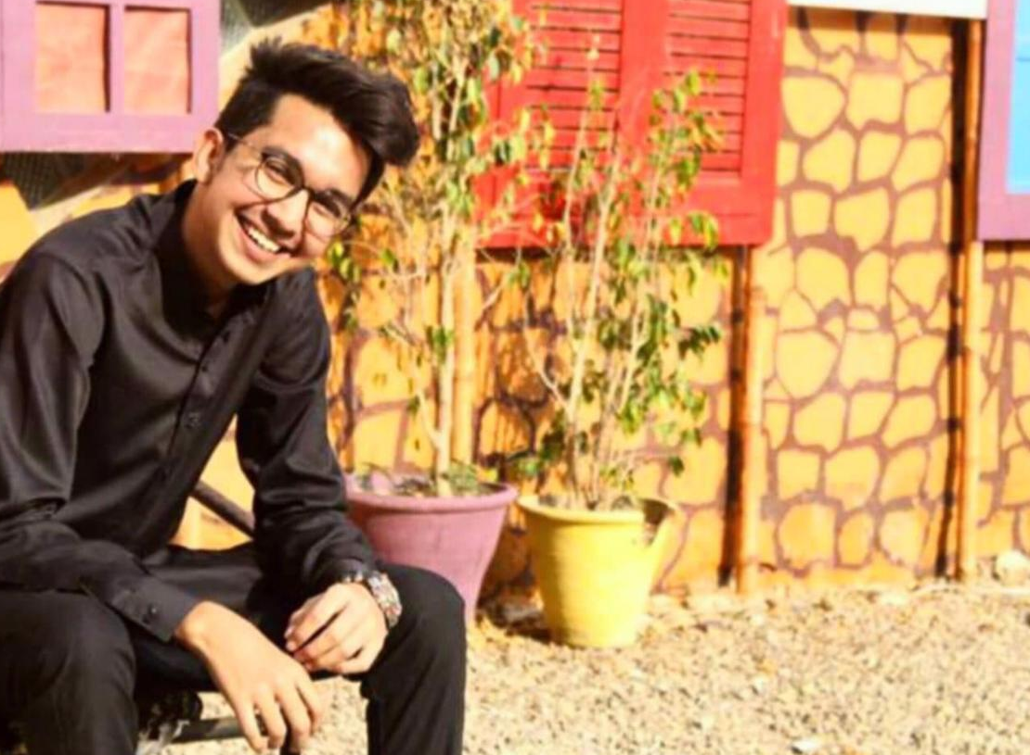
ICA ASSIGNMENT ABOUT MYSELF
Ahmed Ghias 24106

Slide 2

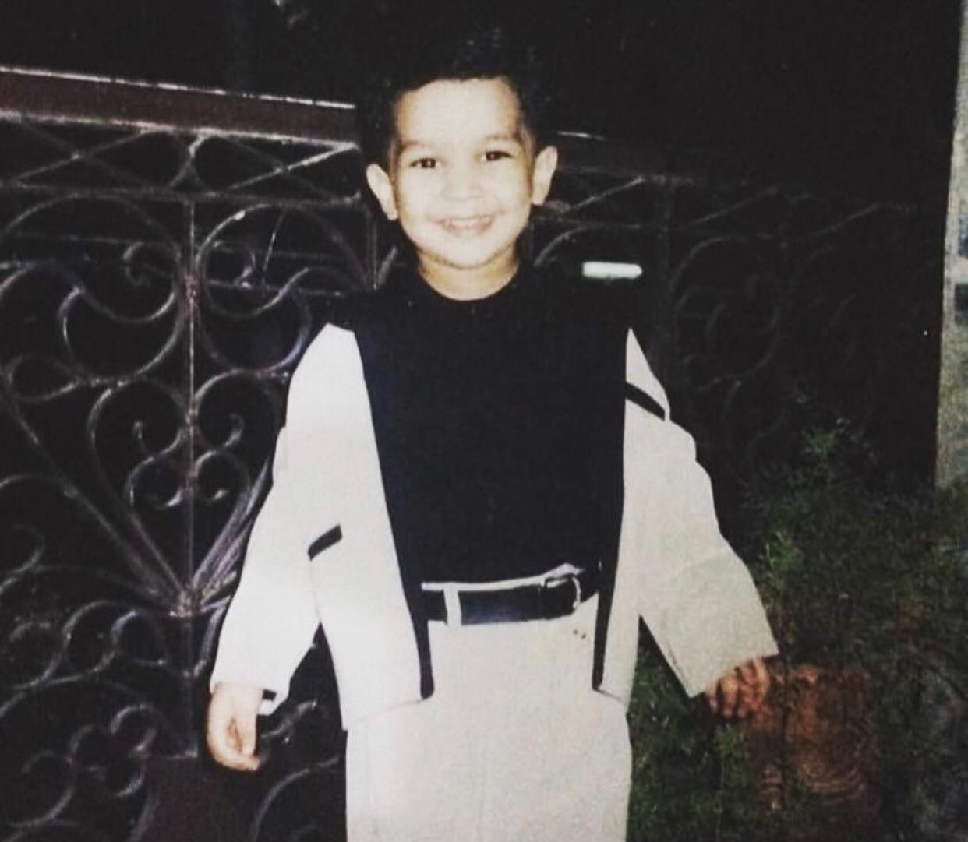
Full Name : Ahmed Ghias Shams Date Of Birth : 08-08-2003 Country : Pakistan City : Karachi Religion : Islam
I am the first child to my parents. I have got 2 younger sisters. A beautiful family of 5 people. Life has been so good so far and hopefully it will remain till the end.

Slide 3
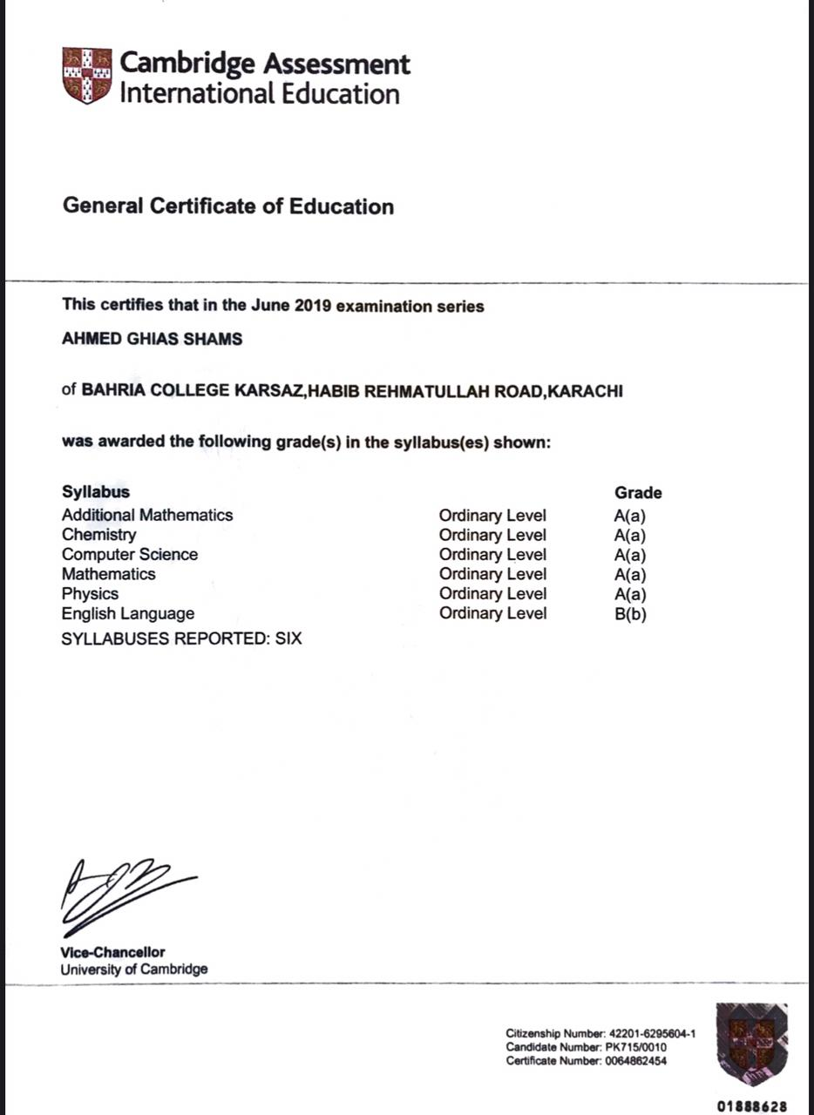
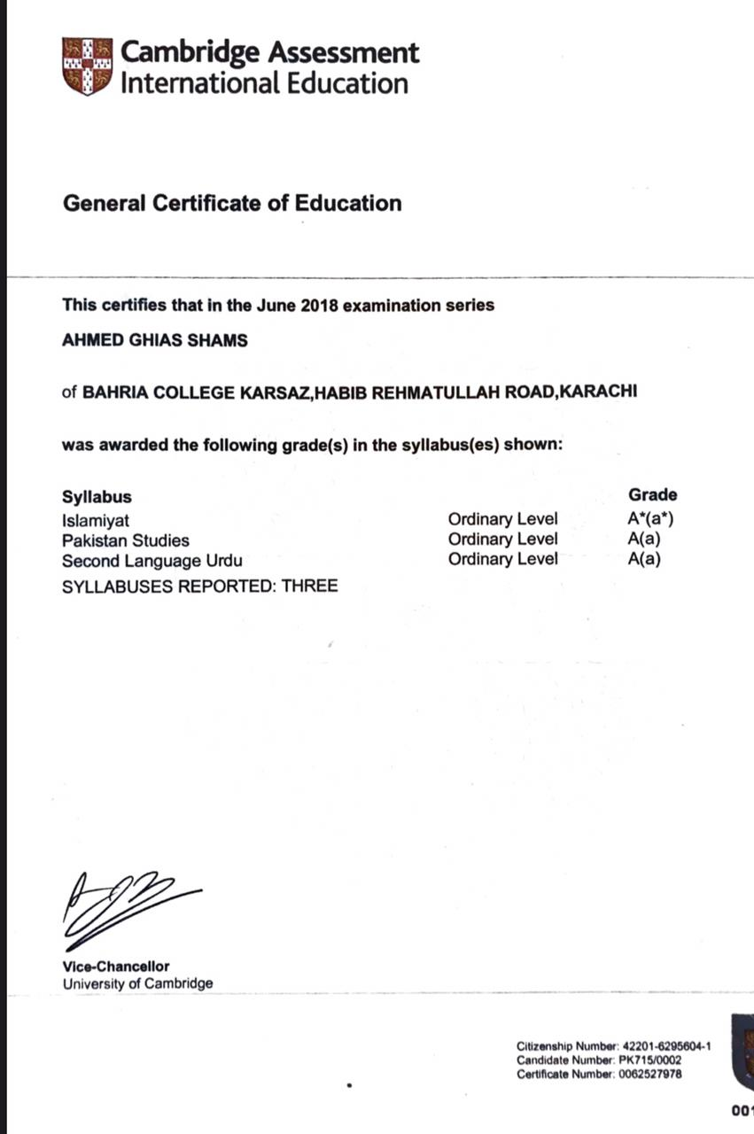
EDUCATION : O’LEVELS FROM BAHRIA COLLEGE KARSAZ A’LEVELS FROM CREDO COLLEGE

Slide 4
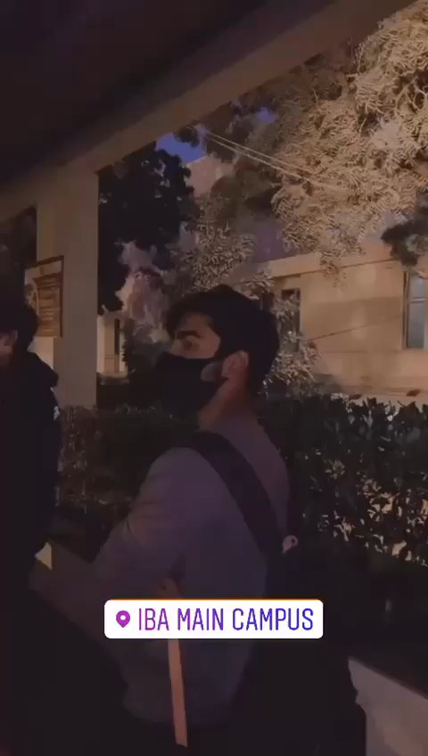
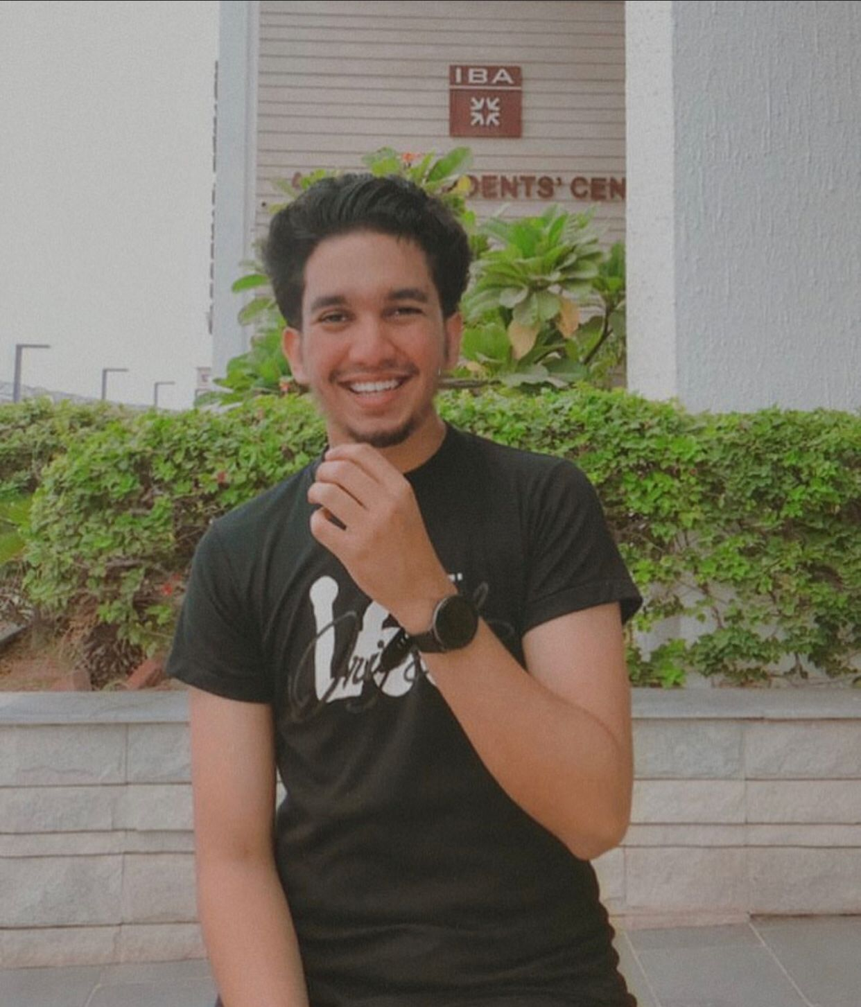
CURRENTLY STUDYING & ENJOYING AT IBA

Slide 5
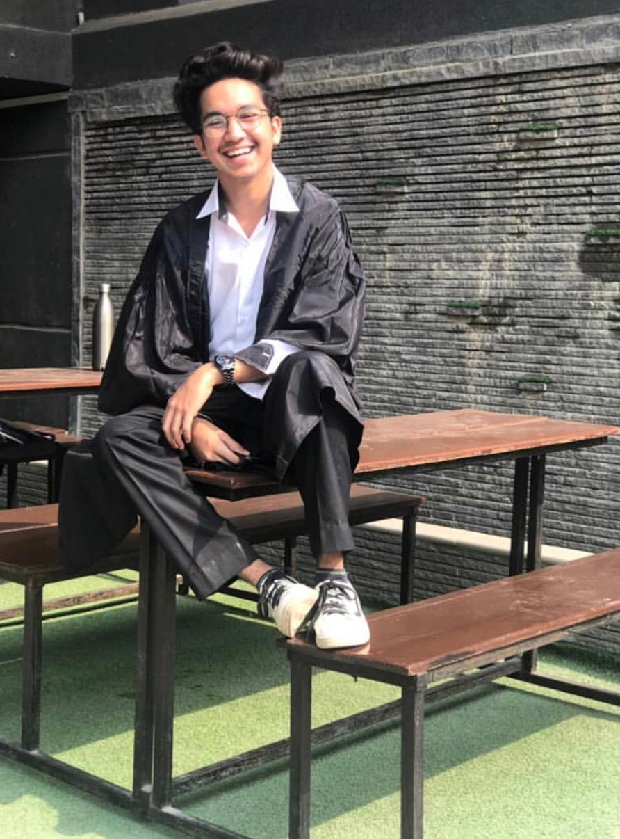
ACHIEVEMENTS : HEADBOY AT SCHOOL DEPUTY HEADBOY AT COLLEGE PRESIDENT OF EVENT MANAGEMENT SOCIETY AT COLLEGE ADMISSION IN IBA

Slide 6

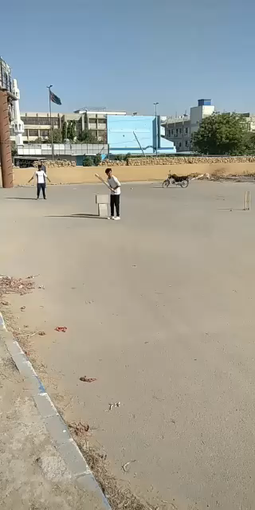
SPORT I LOVE TO PLAY : CRICKET ONLY!

Slide 7
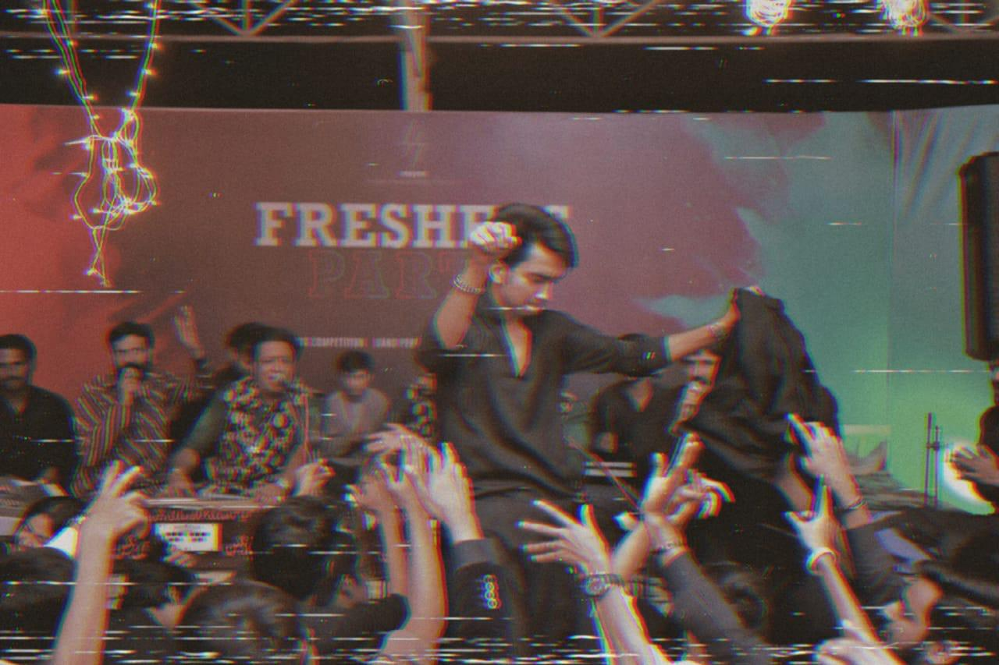
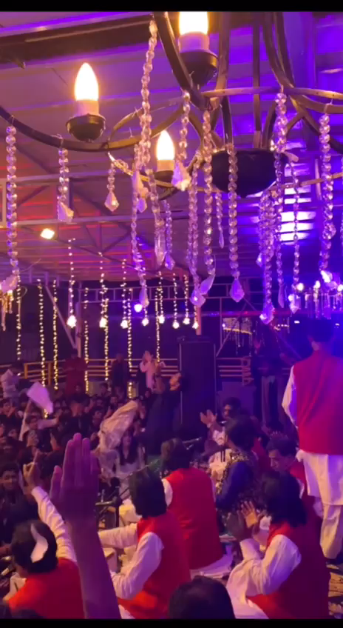
PASSIONATE ABOUT : EVENT MANAGEMENT. ORGANISED MY OWN EVENTS. LOVE ATTENDING QAWWALIS.

Slide 8
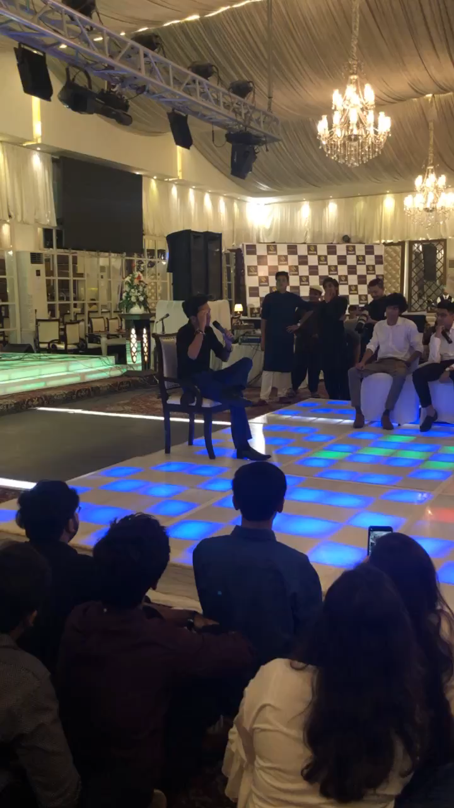
LOVE TO DO : ACTING. This is a video of mine acting at a welcome party!

Slide 9





SHOW THAT I LOVE THE MOST : NARUTO!

Slide 10

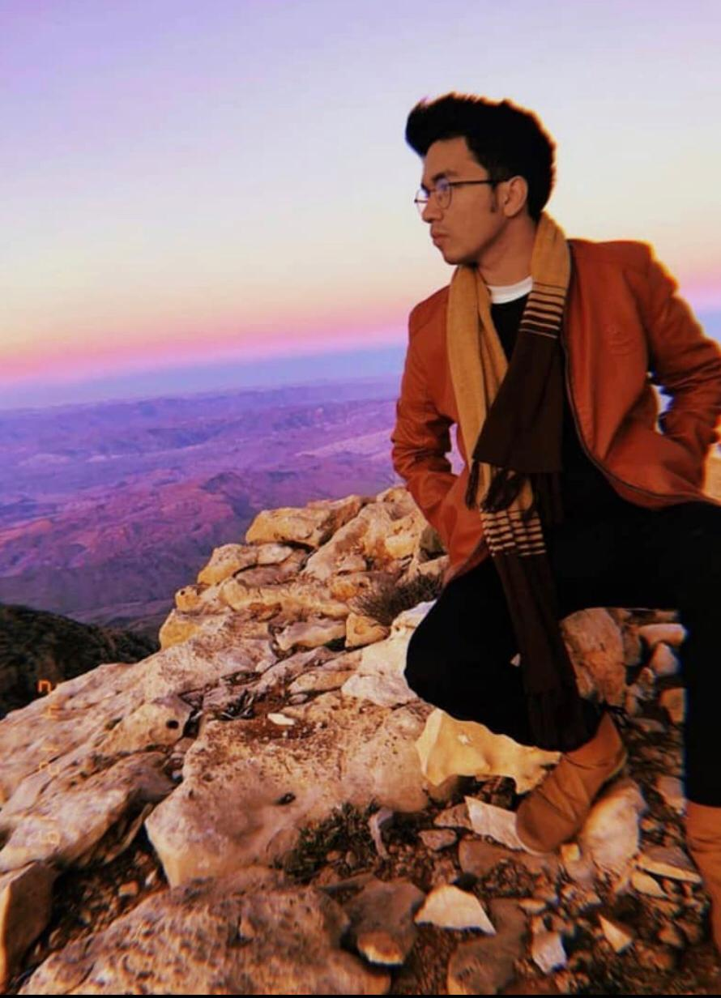

DREAM : WORLD TOUR MY ONE AND ONLY DREAM. PRAY THAT IT GETS FULFILLED AND THANKYOU FOR VIEWING A BIT ABOUT MY PERSONAL LIFE!

